Slide 1
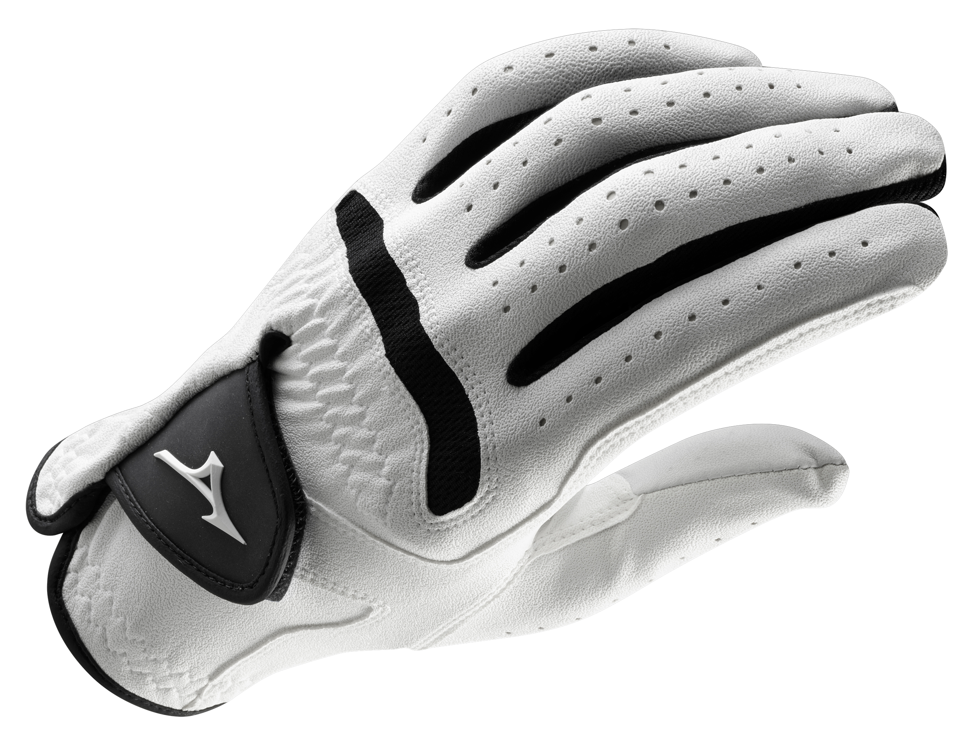

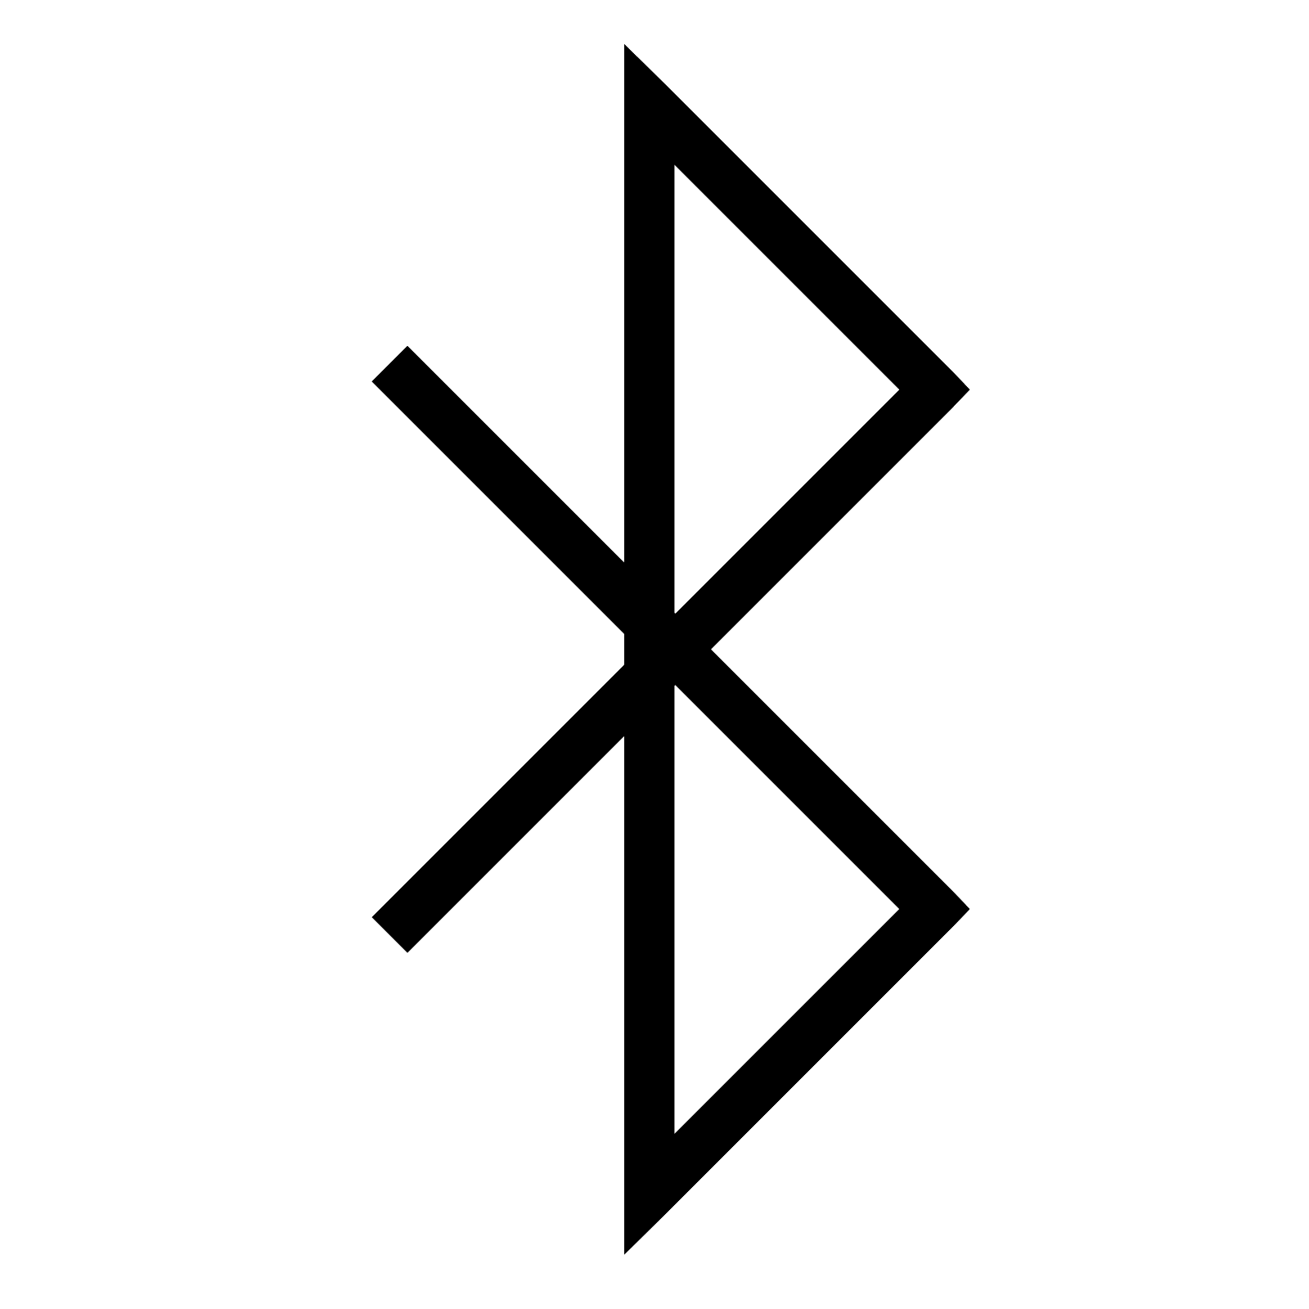


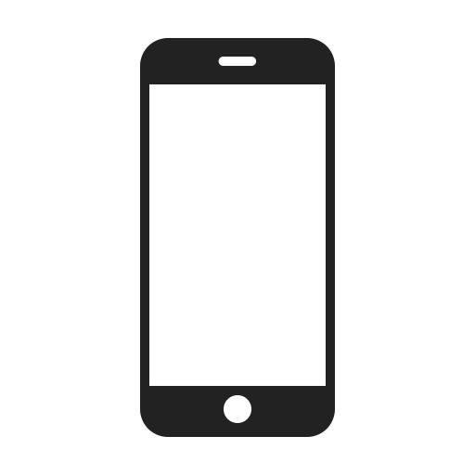
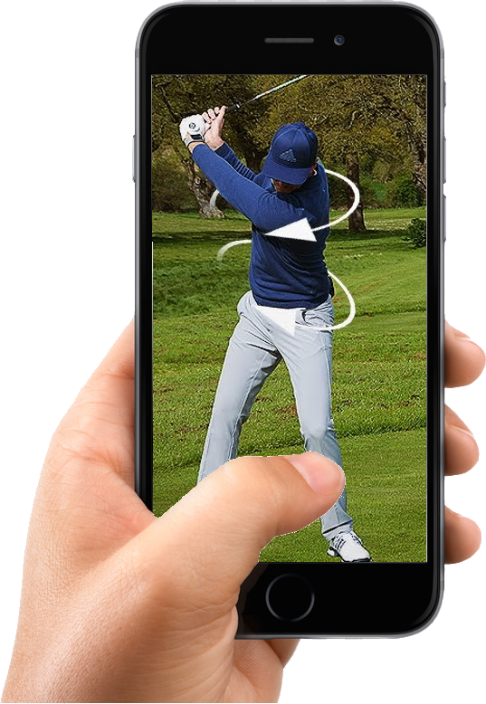
Golf Glove
Applications:
Gather real-time information about golf technique
System can be paired with autonomous application to give helpful tips to user
Record and replay previous golf swings for analysis
Features:
Controlled by app
Sweat resistant and shock-proof
Replacement gloves for continued use
Adjustable wrist strap
Battery monitoring
Records swing to improve form
Specifications:
20 feet Bluetooth communication between control device and unit
Minimum 2 hour battery life
Able to measure grip pressure
Gyroscope and accelerometer to record and replay forearm position
Detects wrist rotation and inflection up to 45 degrees

